Slide 1
I Am a Designee, Now What Do I Do?
Texas Office of Court Administration
Melissa Astrowski, Bail and Pretrial Program Manager
Webinar - January 28, 2026
Notes:
Introduce self and Clarence
Thank you.

Slide 2
Mandatory Email Notifications
Purpose: To provide deeper understanding of the mandatory email notification process and the role of the designee.
Audience: Receipts of Notifications
District Attorney Designee – Violent Offense Within Same County
Cross County Designee – Out of Jail On Felony Bail In My County and Now Has New Felony Out Of County
Take Aways For Today:
Why Do Notifications Exist?
What Triggers a Notification?
What Should I, As The Designee Expect to Receive?
What Action Is Expected or Required Of Me After Receiving the Notification?
Notes:
Talking Points
This session is for recipients of notifications:
District Attorney designees
Cross-County designees
Goal today:
Explain why these notifications exist
Explain what triggers them
Clarify what you should expect to receive
Clarify what action, if any, is required of you

Slide 3
Why Notifications Exist
Legislature identified a recurring problem:
Defendants released on felony bail in one county, and then arrested for new felonies or violent offenses elsewhere
Prosecutors and courts often did not know in real time
Texas bail reform is focused on:
Public safety
Victim safety
Judicial transparency
Inter-county communication
Notifications are designed to:
Close that information gap
Ensure the right people are notified quickly and consistently
Notes:
Talking Points
Legislature identified a recurring problem:
Defendants released on felony bail in one county
Then arrested for new felonies or violent offenses elsewhere
Prosecutors and courts often did not know in real time
Texas bail reform is focused on:
Public safety
Victim safety
Judicial transparency
Inter-county communication
Notifications are designed to:
Close that information gap
Ensure the right people know quickly and consistently

Slide 4
Statutory Authority Notifications
Statute
Art. 17.027, Code of Criminal Procedure
(2) if a defendant is charged with committing an offense punishable as a felony while released on bail for another pending offense punishable as a felony and the subsequent offense was committed in a different county than the previous offense, electronic notice of the charge must be promptly given to the court specified by Subdivision (1) for purposes of reevaluating the bail decision, determining whether any bail conditions were violated, or taking any other applicable action.
(c) The local administrative district judge for each county shall designate an individual to receive electronic notices under Subsection (a)(2). The county shall ensure that the name and contact information of the individual designated to receive notices under this subsection are included in the public safety report system developed under Article 17.021.
(d) An individual designated under Subsection (c) who receives an electronic notice under Subsection (a) shall promptly provide the notice to the court specified by Subsection (a)(1), to the district clerk, and to the attorney representing the state and the defendant's attorney, if known, in the pending case for the offense for which the defendant was initially released on bail. A notice provided under this subsection does not constitute an ex parte communication.
(a-1) If a defendant is taken before a magistrate for committing an offense punishable as a felony while released on bail for another offense punishable as a felony, the court before which the case for the previous offense is pending shall consider whether to revoke or modify the terms of the previous bond or to otherwise reevaluate the previous bail decision.
Statute
Art. 72.038, Texas Government Code
(c-1) The office shall provide to the elected district attorney in each county an electronic copy of the form submitted to the office under Subsection (c) for each defendant whose bail is set in the county for an offense involving violence, as defined by Article 17.03, Code of Criminal Procedure. An elected district attorney shall provide an e-mail address to the office for the purpose of receiving a form as provided by this subsection.
(2) "Offense involving violence" means an offense under the following provisions of the Penal Code:
(A) Section 19.02 (murder); (B) Section 19.03 (capital murder); (C) Section 20.03 (kidnapping); (D) Section 20.04 (aggravated kidnapping);(E) Section 20A.02 (trafficking of persons);(F) Section 20A.03 (continuous trafficking of persons);(G) Section 21.02 (continuous sexual abuse of young child or disabled individual);(H) Section 21.11 (indecency with a child);(I) Section 22.01(a)(1) (assault), if the offense is:(i) punishable as a felony of the second degree under Subsection (b-2) of that section; or(ii) punishable as a felony and involved family violence as defined by Section 71.004, Family Code;(J) Section 22.011 (sexual assault);(K) Section 22.02 (aggravated assault);(L) Section 22.021 (aggravated sexual assault);(M) Section 22.04 (injury to a child, elderly individual, or disabled individual);(N) Section 25.072 (repeated violation of certain court orders or conditions of bond in family violence, child abuse or neglect, sexual assault or abuse, indecent assault, stalking, or trafficking case);(O) Section 25.11 (continuous violence against the family);(P) Section 29.03 (aggravated robbery);(Q) Section 38.14 (taking or attempting to take weapon from peace officer, federal special investigator, employee or official of correctional facility, parole officer, community supervision and corrections department officer, or commissioned security officer);(R) Section 43.04 (aggravated promotion of prostitution), if the defendant is not alleged to have engaged in conduct constituting an offense under Section 43.02(a);(S) Section 43.05 (compelling prostitution); or(T) Section 43.25 (sexual performance by a child).
Notes:
3. Legislative Foundation (2 minutes)
Talking Points
Senate Bill 6 (87th Legislature) created mandatory electronic notifications
Senate Bill 9 standardized and strengthened the framework
The statutes require:
Notifications be electronic
Notifications be timely

Slide 5
DA Notification – when is it sent?
District Attorney Notification – Trigger
A case is flagged as notification required when defendant and charge information is being set up within the PSRS prior to magistration to generate the Public Safety Report.
The flag generates if the offense entered is a violent felony as described in Article 17.03, CCP.
After magistration the bail decision is memorialized in the Bail Form, and a second flag reminds user that notification is required.
Magistrate or their designee is then able to make notification. *Notifications are also captured in the PSRS
Example 1: Waldo is arrested and magistrated after being charged with Aggravated Robbery in Armstrong County. Armstrong County staff (generally, the person certifying the bail form) is required to generate notification to Armstrong County District Attorney within the PSRS.
Example 2: Dora has a warrant for murder in Hays County, and during a routine traffic stop in Hidalgo County is arrested on-site for the outstanding warrant. The DA designee in BOTH Hays County and Hidalgo County must be notified. Why? Because the statute indicates the DA for the county in which bail is set (Hidalgo) must be notified. However, because there is no prosecutorial action necessary by Hidalgo, best practice is to also notify Hays.
Notes:
5. District Attorney Notification – Trigger Talking Points
Triggered when:
Bail is set and Bail Form is Certified
For an offense involving violence under Article 17.03
Statute ties notification to:
County where bail is set
PSRS automatically attaches:
Most recently completed bail form (PDF)

Slide 6
Da Notification What is in the email?
Subject Line: Felony Arrest Notification under 72.038 Government Code
Date: Auto Filled by System
To Whom It May Concern:
This serves as electronic notification pursuant to Article 72.038 (c-1), Texas Government Code: The office (Office of Court Administration) shall provide to the elected district attorney in each county an electronic copy of the form submitted to the office under Subsection (c) for each defendant whose bail is set in the county for an offense involving violence, as defined by Article 17.03, Code of Criminal Procedure. An elected district attorney shall provide an e-mail address to the office for the purpose of receiving a form as provided by this subsection.
A felony offense involving violence (as defined in 17.03 within the Code of Criminal Procedure) has resulted in an arrest in your jurisdiction. Details are listed below, and supplemental bail information is attached.
Defendant Name: Auto Filled by System
DOB: Auto Filled by System
SID or FBI: Auto Filled by System
Arrest Date: Auto Filled by System
Offense(s): Auto Filled by System
If you have questions or concerns regarding this information, please reach out to the appropriate stakeholders in your jurisdiction. If you are receiving this message in error or the designee information needs to be changed or updated, please send correspondence to Bail@txcourts.gov.
Notes:
6. District Attorney Notification – What You Receive Slide Title: Talking Points
Defendant identifying information
Offense(s)
Bail amount and type
Attached bail form PDF
Sent to email address provided by the elected DA

Slide 7
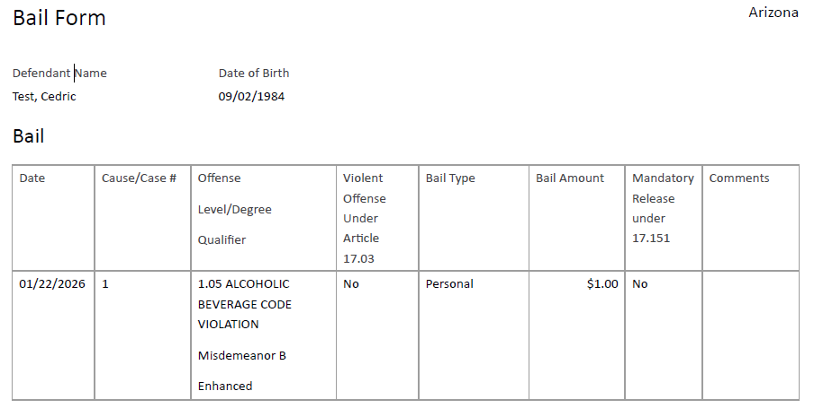

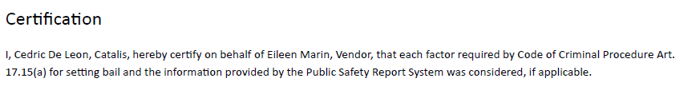
Da Notification What is the Attachment?

Slide 8
Da Designee responsibilities
Route internally through established department operating procedure.
BECAUSE
A DA must receive notice when a magistrate sets bail in that county on a violent offense — because the DA is the lead prosecutor and must know the terms and conditions of release as early as possible to determine whether the bail decision supports public safety.
A DA must also receive electronic notice when a defendant on bail in their county is arrested for a new felony in another county — so the prosecutor has the facts needed to revisit bail, consider conditional bail changes, or take appropriate action.
In both cases, the legislative purpose is the same: to equip the elected prosecutor with timely, actionable information and determine if additional action is necessary.
Notes:
Ensure the elected DA’s office receives the notification
Route internally per local practice
Use information to:
Support charging decisions
Consider bail challenges
No requirement to respond back in PSRS
No requirement to send onward notifications unless locally assigned

Slide 9
Cross-County – when is it sent?
Cross-County Notification – Trigger
Review of the criminal history is required by the county where the defendant is being charged and magistrated.
If there are is a pending felony (no disposition listed in the criminal history), notification must be made after magistration.
When a user is unsure because there is no disposition on a felony, notification will be sent in an abundance of caution.
Example: Waldo was released on bail in Armstrong County to await trial. He has now been arrested in Zapata County for a 3rd degree Possession of a Controlled Substance. Zapata County staff (generally, the person certifying the bail form) is required to generate notification to Armstrong County within the PSRS.
Notes:
8. Cross-County Notification – Trigger Talking Points
Triggered when:
Defendant is released on bail for a felony in County A
Defendant is arrested for a new felony in County B
Purpose:
Notify the county where the defendant is already on felony bail

Slide 10
Cross-County Email Notification
Subject Line: Cross County Felony Arrest Notification Under 17.027 CCP
Date: Auto Filled by System
To Whom It May Concern:
You have been identified as the designee to receive this electronic notification Pursuant to Article 17.027 (a) (2), Code of Criminal Procedure: If a defendant is taken before a magistrate for committing an offense punishable as a felony while released on bail for another offense punishable as a felony, the court before which the case for the previous offense is pending shall consider whether to revoke or modify the terms of the previous bond or to otherwise reevaluate the previous bail decision.
Pursuant to 17.027 (c) (d) as the designee to receive this notification you are required to promptly provide notice to the court, the district clerk, the attorney representing the state and the defendant’s attorney if known.
Details are listed below.
Defendant Name: Auto Filled by System
DOB: Auto Filled by System
SID or FBI: Auto Filled by System
County of New Arrest: Auto Filled by System
Arrest Date: Auto Filled by System
Offense(s): Auto Filled by System
If you have questions or concerns regarding this information, please reach out to the appropriate stakeholders in your jurisdiction. If you are receiving this message in error or the designee information needs to be changed or updated, please send correspondence to Bail@txcourts.gov. If you are a prosecutor, you may access the bail form in the PSRS. If you have not yet been entered into the PSRS please visit https://www.txcourts.gov/bail/ to fill out the Prosecutor Request Form and email to Bail@txcourts.gov
Notes:
9. Cross-County Notification – What Talking Points
Defendant identifying information
New arrest county and offense
Attached most recent bail form

Slide 11
Cross-County Designee Responsibilities
Upon receipt of notification the designee is statutorily responsible for FOUR Notifications:
District Attorney’s Office
District Clerk’s Office
District Court where original felony is assigned
Defense attorney, if known
BECAUSE
the court before which the case for the previous offense is pending shall consider whether to revoke or modify the terms of the previous bond or to otherwise reevaluate the previous bail decision.
Notes:
0. Cross-County Designee – What You Are Expected to Do (2 minutes)
Slide Title: Cross-County Designee Responsibilities
Talking Points
Confirm your county has a pending felony case
Route to appropriate parties based on local procedure:
DA
Court
Clerk
Purpose is awareness and coordination
PSRS supports sending notifications to multiple counties (one at a time)

Slide 12
In Summary
Your Responsibilities Are
RECEIPT ROUTING OPERATIONAL DISSEMINATION
You are NOT responsible for:
Generating and sending the notification from the PSRS system.
Entering anything into the PSRS.
Modifying or editing the Bail Form.
Notes:
11. What Designees Are NOT Responsible For Talking Points
You are not determining:
Whether the offense is violent
Whether notification was legally required
You are not editing bail forms
You are not entering bond conditions into TCIC/NCIC
Your role is receipt, routing, and awareness

Slide 13
Frequently Asked Questions:
Q. | Is there a difference between who sends the PSRS notification and the designee who receives it?
 | Yes. The person sending the PSRS notification is a PSRS user that begins the notification process, based on local workflow. The designee is the statutorily identified person who receives the notification and is responsible for ensuring it is distributed and acted upon in accordance with statute and local procedure.
Q. | How do we know who the designee’s are for the district attorney, district clerk, district court where the case is pending and defense attorney when known?
 | The Local Administrative District Judge designates the person responsible for receiving cross-county notifications under Article 17.027. That designee, using local procedure, determines and maintains the appropriate contacts for the district attorney, district clerk, court of record, and defense counsel when known. OCA only maintains the LADJ and DA designee lists; all other distribution contacts are managed locally.
Q. | If I receive a cross-county notice for someone with no local case, why did I receive it?
 | Cross-county notifications are sent based on information in the criminal history. The notification alerts your jurisdiction that the defendant may have a pending felony case in your county. It is possible the case has already been resolved but not yet updated in TCIC, or that the arrest occurred in a city spanning multiple counties and the notification was sent to each county out of an abundance of caution.
Q. | Who sends the notice to the other county?
 | The PSRS notification is generated by an authorized PSRS user in the arresting county. Each jurisdiction is responsible for defining its local workflow and identifying who is responsible for performing this duty to ensure timely compliance.
A robust FAQ can be located at Email Notification FAQ
Notes:
12. Common Scenarios & Misunderstandings Talking Points
“Why did I receive both notifications?”
Different statutes, different purposes
“Can PSRS confirm if a notification was sent?”
Yes, through system audit history (if you have access)

Slide 14
The Importance Of Your Role As The Designee
Support statutory compliance by ensuring required notifications are properly routed and acted upon.
Promote timely prosecutorial awareness in cases involving violent offenses and cross-county felony activity.
Help preserve accurate case flow across courts, clerks, prosecutors, and pretrial services.
Reduce the risk of missed notifications, delayed action, or downstream errors.
Strengthen system reliability without requiring judges or prosecutors to perform technical system tasks.
You are the human link in a statutory safety net.
Notes:
13. Why This Matters to You (1 minute)
Slide Title: Why Your Role Matters
Talking Points
You are the human link in a statutory safety net
Timely routing supports:
Safer bail decisions
Informed prosecutors
Stronger court records
This is not about changing discretion It is about ensuring discretion is informed

Slide 15
Assistance and Training Resources:
Bail & Pretrial section of the OCA website: https://www.txcourts.gov/bail/
Prosecutor specific information regarding Senate Bill 9: https://www.txcourts.gov/bail/prosecutor-information/
Extensive FAQ for Mandatory Email Notifications: https://www.txcourts.gov/media/1461985/email-notificaiton-faq-12026.pdf
Email questions to: Bail@txcourts.gov
Notes:
14. Resources & Support (1 minute)
Slide Title: Help & Training
Talking Points
PSRS website
FAQs
Job aids
OCA Bail & Pretrial Team contact
Ongoing webinars and office hours

Slide 16
Thank You!
Your Role is Critical!
You Efforts Help Make OUR Communities Safer!
We Are Here to Support YOU!
Bail@txcourts.gov & https://www.txcourts.gov/bail/
Notes:
15. Closing (1 minute)
Slide Title: Key Takeaways
Talking Points
Two notifications
Two different triggers
Clear designee roles
You are not alone—we support you

