Slide 1

DNA Interpretation Basics
Garon Foster
Bexar County Criminal Investigation Laboratory
Understanding Forensic DNA Analysis: A Program for Lawyers and Judges
Presented at the Texas State Capitol Auditorium on November 2, 2023

Slide 2
Forensic DNA Analysis
The goal of the presentation will be to introduce:
What is DNA, where does DNA come from and what makes each of us unique
What is forensic DNA analysis
How is a genetic profile developed and what does it look like
The basics of interpreting a genetic profile from a single contributor and from multiple contributors
Notes:
1) With very little basic biology, you will understand the terms, then understand the basics behind forensic DNA comparison

Slide 3
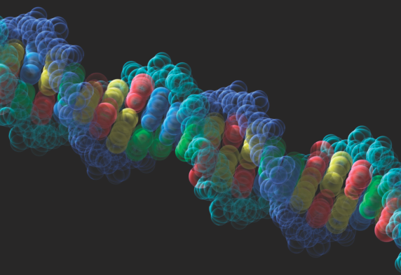
What is DNA?
DNA (Deoxyribonucleic Acid) is a chemical substance located in nucleus of every cell in your body (except red blood cells)
DNA is inherited from your mother and father
Its purpose is to instruct the body on how to make proteins and serves as a template for cellular reproduction
DNA is the same in every cell of your body
DNA is unique to each person (except identical twins) and does not change over a person’s lifetime
Notes:
Trillions of cells, Even twins will have differences, many diseases can alter a portion of DNA (cancer)

Slide 4
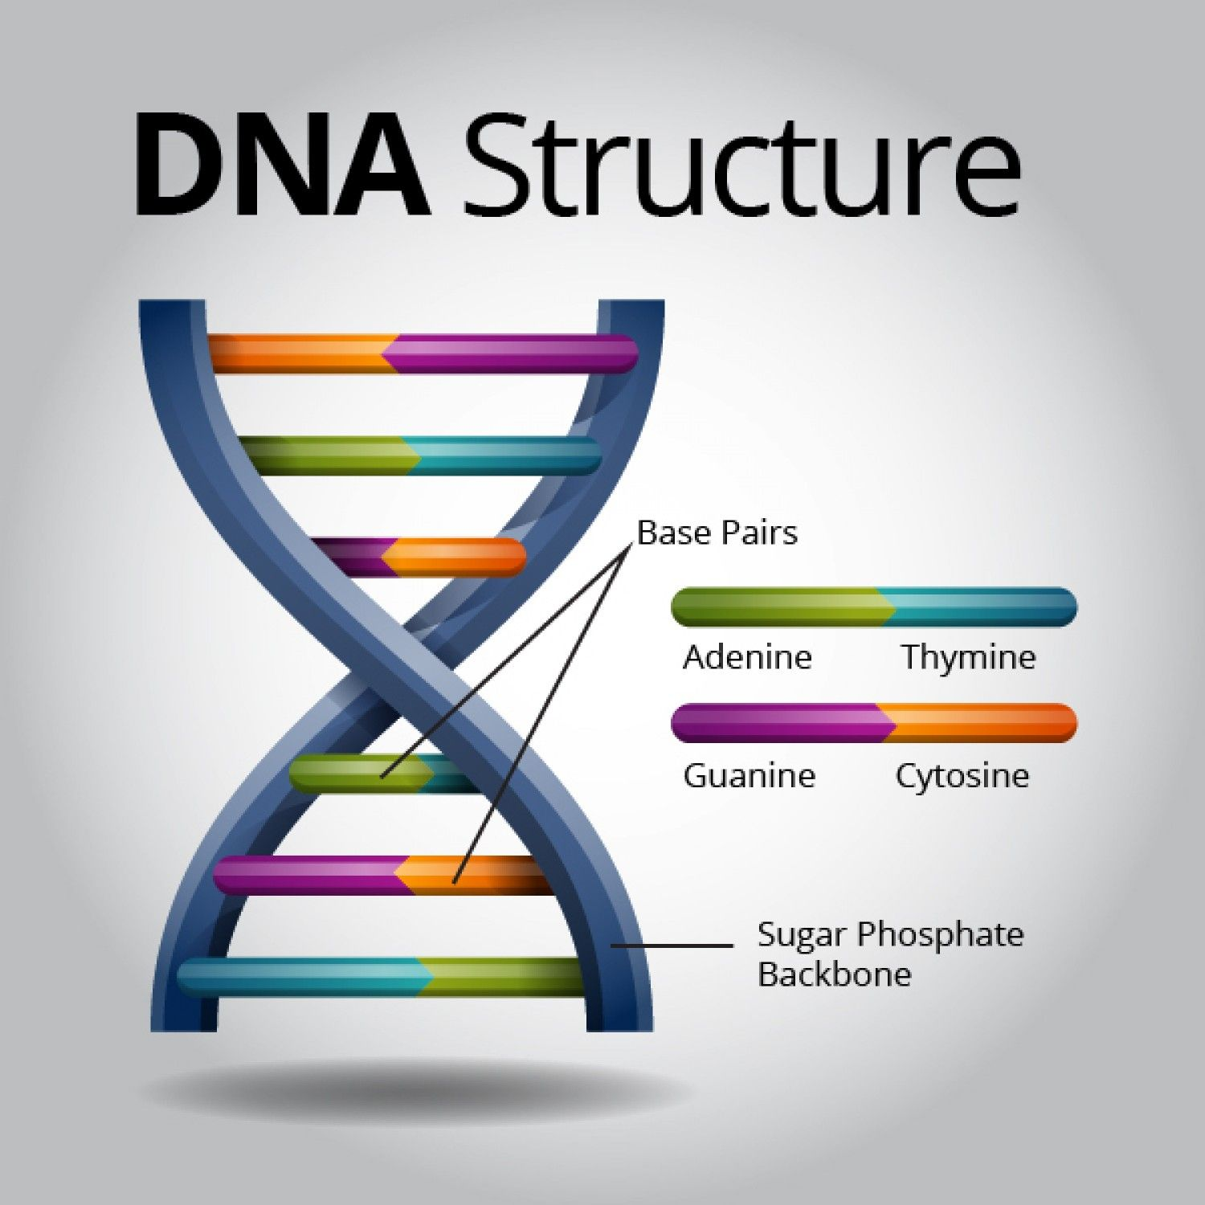
What is DNA?
DNA is a long molecule consisting of two strands wound together in the form of a double helix
The strands are held together by the pairing of four nucleotide bases (G,C,A,T)
There are ~300 billion nucleotide bases in each cell making up the person’s entire genome
The sequence and number of nucleotide bases is what makes each person unique

Slide 5
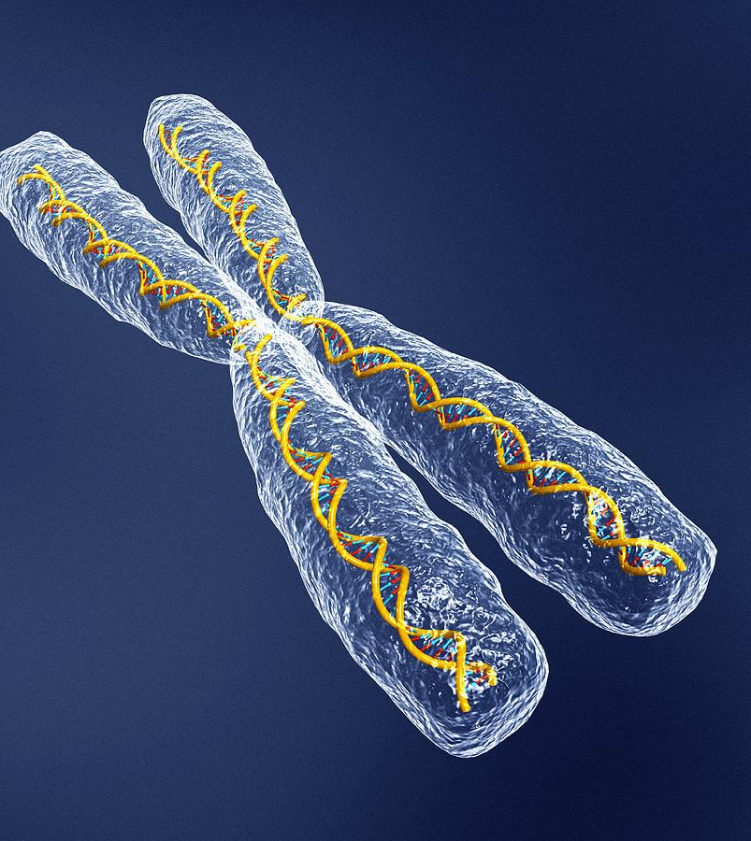
How is DNA Packaged?
DNA is packaged very tightly in a structure called a chromosome
The human body has 23 pairs of chromosomes
One chromosome in the pair is inherited from your mother and the other chromosome in the pair is inherited from your father
One of the 23 pairs of chromosomes is called the sex chromosomes (XX or XY)
Forensic DNA analysts use both the sex chromosomes and the other 22 pairs of chromosomes (called autosomes)
Notes:
For a total of 46 chromosomes

Slide 6
Forensic DNA Analysis
Forensic DNA analysis - developing a genetic profile from biological material to help determine if someone may (or may not) have been a possible donor of the DNA in the biological sample
Forensic DNA analysis does not indicate how the biological material was deposited on the item
Forensic DNA analysis does not indicate when the biological material was deposited on the item
The questions of how and when may be inferred by the trier of fact, but the forensic DNA analyst must exercise caution if requested to comment on the hierarchy of propositions other than ‘the (sub)source of the DNA’
Notes:
Offense (guilt or innocence - rape), Activity (sexual intercourse), Source (biofluid), Sub-source (DNA) - does not tell us bodily fluid source (use steering wheel example), what is our job / our role, thanks to attorneys and judges for all they do in the course of the trial,

Slide 7
How are we different?
DNA is polymorphic (having more than one form giving variation to genetic code)
  Sequence Polymorphisms …G-A-T-G-A-T-G-A-T…
  …G-A-T-C-A-T-G-A-T…
  Length Polymorphisms
AATG
STRs
7 short tandem repeats
8 short tandem repeats
Notes:
Length polymorphisms – STRs, provides the discrimination in the profile

Slide 8
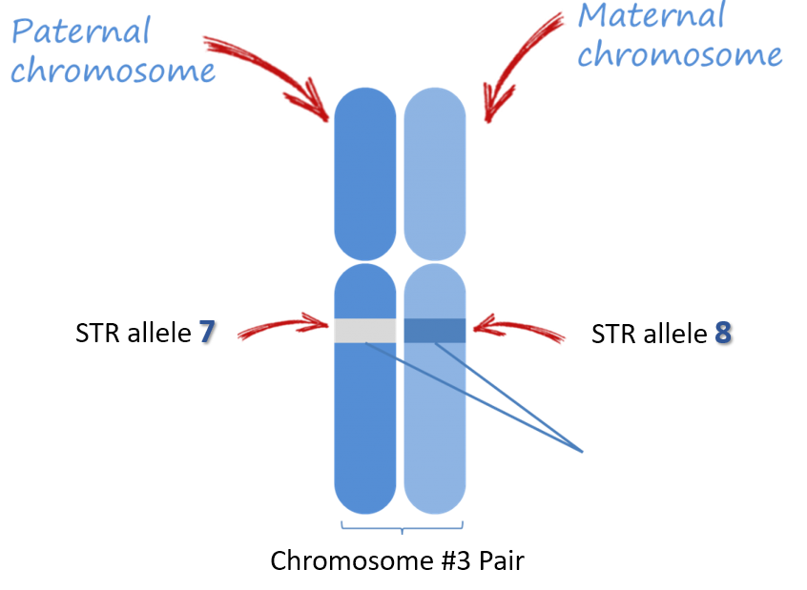
Forensic DNA Terminology
Gene – unit of heredity on the chromosome
Locus – location (name) of the gene
Allele – alternate forms of the same gene
Genotype – the two alleles inherited at a locus
Unit of Heredity
Notes:
Genes – people think of areas that code for proteins but it is any unit of heredity or unit of interest (ABO genes, blue eye genes)

Slide 9
Forensic DNA Terminology
Gene – unit of heredity on the chromosome
Locus – location (name) of the gene
Allele – alternate forms of the same gene
Genotype – the two alleles inherited at a locus
D3S1358 or BRCA1
Notes:
Genes – people think of areas that code for proteins but it is any unit of heredity or unit of interest (ABO genes, blue eye genes)

Slide 10
Forensic DNA Terminology
Gene – unit of heredity on the chromosome
Locus – location (name) of the gene
Allele – alternate forms of the same gene
Genotype – the two alleles inherited at a locus
STRs: 6,7,
8,9,10,11,
12,13….
Notes:
Genes – people think of areas that code for proteins but it is any unit of heredity or unit of interest (ABO genes, blue eye genes)

Slide 11
Forensic DNA Terminology
Gene – unit of heredity on the chromosome
Locus – location (name) of the gene
Allele – alternate forms of the same gene
Genotype – the two alleles inherited at a locus
[7,8]
Notes:
Genes – people think of areas that code for proteins but it is any unit of heredity or unit of interest (ABO genes, blue eye genes)

Slide 12
Forensic DNA Terminology
Gene – unit of heredity on the chromosome
Locus – location (name) of the gene
Allele – alternate forms of the same gene
Genotype – the two alleles inherited at a locus
Putting it all together: The POI’s genotype at locus D3S1358 is [7,8]
D3S1358
[7,8]
Notes:
Genes – people think of areas that code for proteins but it is any unit of heredity or unit of interest (ABO genes, blue eye genes)

Slide 13
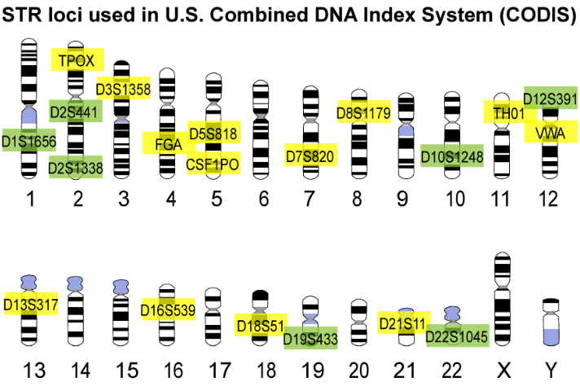
Forensic DNA Analysis
Thousands of genetic locations (loci) available
Most loci are genes that code for a protein and are not very polymorphic in the population
Forensic scientists focus on polymorphic loci that do not code for a protein (‘junk DNA’) or phenotypic trait
D = DNA
12 = chromosome #
S = single gene
391 = location on chromosome
Twenty (20) Core CODIS Loci (Autosomes)
Sex Chromosomes
Notes:
Nomenclature, 2017

Slide 14

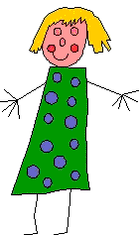
Forensic DNA Analysis
Inheritance of DNA (one chromosome from each parent)
mom
dad
Sex Chromosome Pair
(one from each parent)
XX
XY
Male
Female
XY
XY
XX

Slide 15
Forensic DNA Analysis
Inheritance of DNA (one allele from each parent)
mom
dad
Autosomes
Two alleles per locus
(one from each parent)
7,8
8,9
Heterozygous
genotype
Homozygous genotype
7,8
7,9
8,8

Slide 16
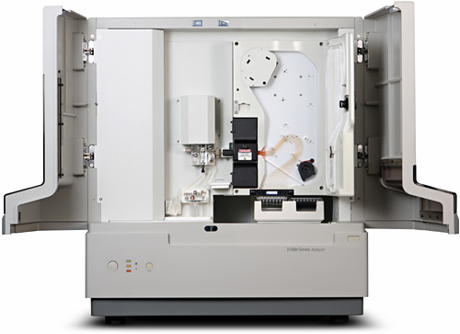
Forensic DNA Analysis
How is the DNA profile developed?
  DNA is extracted from the biological material
  DNA is quantified to determine if sufficient material present
  DNA is amplified at multiple loci using polymerase chain reaction (PCR)
  DNA is separated by size using electrophoresis on a genetic analyzer
Notes:
Genetic analyzer - This is where the largest changes in technology – separate DNA based on size fragments (STRS)/ columns, polymer, laser induced fluorescence, multi capillaries , multiplexes

Slide 17
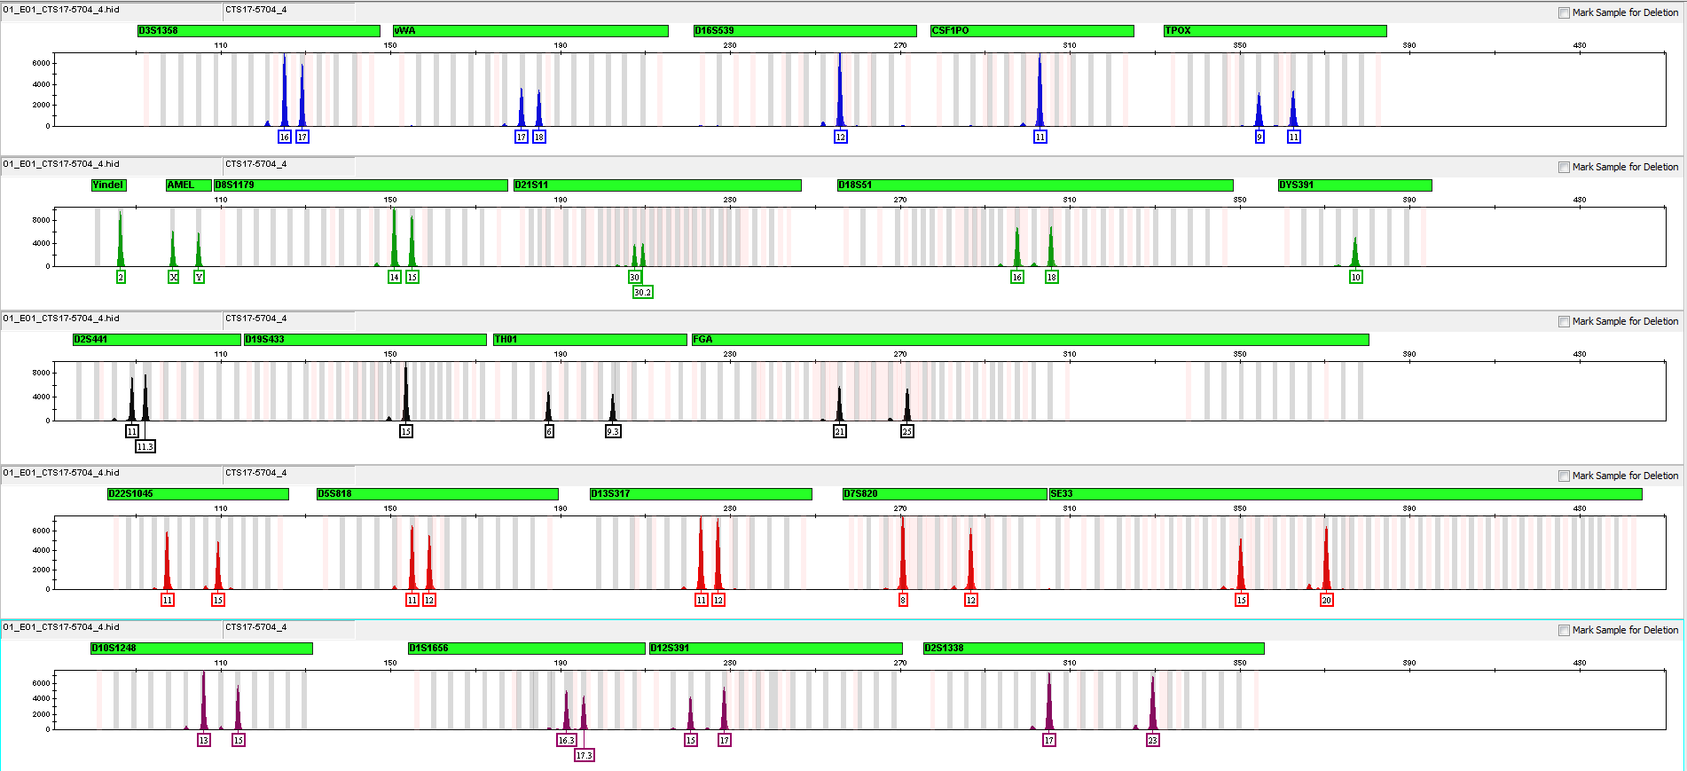
Forensic DNA Analysis
What does a genetic profile look like?
Locus D18S51
Genotype [16,18]
Electropherogram
Notes:
Genetic profile – combination of the genotypes developed at each locus, Y axis fluorescent RFUs, X axis base pairs

Slide 18
Forensic DNA Analysis
What does a genetic profile look like?
Locus D16S539
Genotype [12,12]
Electropherogram
Notes:
Genetic profile – combination of the genotypes developed at each locus, Y axis fluorescent RFUs, X axis base pairs

Slide 19
Forensic DNA Analysis
What does a genetic profile look like?
Locus Amelogenin
Genotype [XY]
Electropherogram
Notes:
Genetic profile – combination of the genotypes developed at each locus, Y axis fluorescent RFUs, X axis base pairs

Slide 20
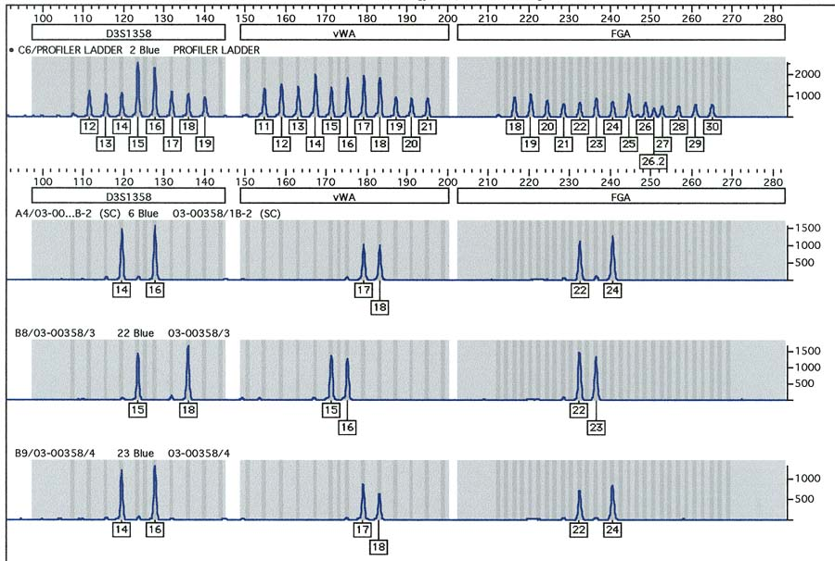
Forensic DNA Analysis
Forensic DNA Comparison – Single Donor Example
DNA on
Vaginal Swab
POI #1
POI #2

Slide 21
Forensic DNA Analysis
Forensic DNA Comparison – Single Donor Example
DNA on
Vaginal Swab
POI #1
POI #2

Slide 22
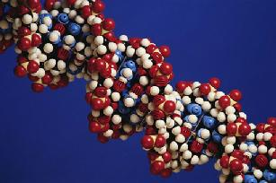
Forensic DNA Analysis
Forensic DNA Comparison: EXCLUSION
POI #1 is EXCLUDED as a source of the DNA
Vaginal Swab
DNA Profile
POI #1
DNA Profile

Slide 23
Forensic DNA Analysis
Forensic DNA Comparison – Single Donor Example
DNA on
Vaginal Swab
POI #1

POI #2

Slide 24
Forensic DNA Analysis
Forensic DNA Comparison: NON-EXCLUSION
POI #2 is NOT EXCLUDED as a source of the DNA
Vaginal Swab
DNA Profile
POI #2
DNA Profile

Slide 25
Forensic DNA Analysis
Evidence profile is the same as a POI profile…. Why?
  Is it because the POI is the donor of the DNA
  Is it because someone other than the POI deposited the evidence and happens to have the same genetic profile as the evidence (random match)
  The forensic DNA analyst will provide a statistic to assist with the weight of evidence
  Population Genetics – study of inherited variation in alelle frequencies within a population. Allows the forensic scientist to estimate the frequency of the observed genotype in the population

Slide 26
Forensic DNA Analysis
Calculating Expected Genotype Frequency
p
q
p
pp
pq
The Punnett Square!
q
pq
qq
p² + 2pq +q² = 1
Homozygous genotype frequency
Notes:
Hardy Weinberg, simplified version only, no theta value correction

Slide 27
Forensic DNA Analysis
Calculating Expected Genotype Frequency
p
q
p
pp
pq
The Punnett Square!
q
pq
qq
p² + 2pq +q² = 1
Heterozygous genotype frequency
Notes:
Hardy Weinberg, simplified version only, no theta value correction

Slide 28
Forensic DNA Analysis
Calculating Expected Genotype Frequency
DNA on
Vaginal Swab
POI #2
f₁₄ = .12
f₁₆ = .18
f₁₇ = .20
f₁₈ = .16
f₂₂ = .04
f₂₄ = .15
Allele Frequency ⇨
2pq
2(.12)(.18)
2pq
2(.20)(.16)
2pq
2(.04)(.15)
Genotype Frequency ⇨
0.0432
x
0.0640
x
0.0120
=
0.00003318
1 in ~23 people
1 in ~16 people
1 in ~83 people
1 in ~30,544 people
Random Match Probability
Probability ⇨
1 / frequency
x
x
=
Notes:
Statistics always on the unknown profile, not the reference standard

Slide 29
Forensic DNA Analysis
Random Match Probability (RMP)
DNA on
Vaginal Swab
POI #2
Report Statement: “POI #2 is not excluded as a source of the human DNA identified on the vaginal swab. Based upon the statistical frequency for the genetic loci examined, the random match probability (RMP) has been calculated. This is the probability of selecting the observed profile from a theoretical population of random unrelated individuals. The RMP is approximately 1 in 30,544.”

Slide 30
Forensic DNA Analysis
Random Match Probability (RMP)
X
X
DNA on
Vaginal Swab
POI #2
The Law of Independent Events – two events are independent of one and the probability of each may be multiplied (combined RMP)
Can you imagine what the discrimination of a twenty-one (21) loci genetic profile would be?

Slide 31
Forensic DNA Analysis
How rare is today’s genetic profile?
POI #2 is not excluded as a source of the human DNA identified on the vaginal swab.
The probability of selecting the observed profile from a theoretical population of random unrelated individuals is approximately 1 in 4,000,000,000,000,000.

Slide 32
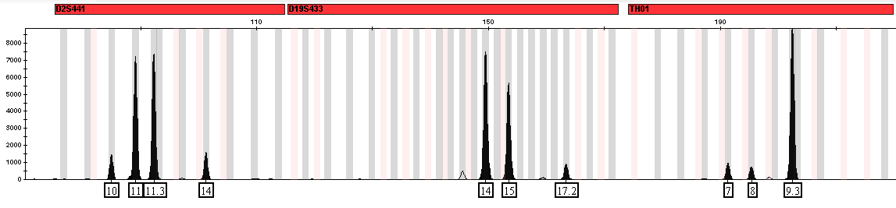
Forensic DNA Analysis
Forensic DNA Mixtures – more than one contributor
Can you provide a weight of evidence in a mixture sample?
  Is a genotype distinguishable in the mixture?
    Yes: Random Match Probability (RMP)
    No: Combined Probability of Inclusion (CPI)
More than two alelles per locus
Allele peak imbalance at a locus
Notes:
What tools do I have to provide a match weight, all binary decisions – yes, no, yes, no, and there are variations (mRMP, rCPI)

Slide 33
Forensic DNA Analysis
Forensic DNA Mixtures
  Distinguishable genotypes in the mixture - RMP
Intimate sample (vaginal swab)
  Condition on the intimate donor’s known profile
    The intimate donor’s profile “subtracted” out
    Assuming two donors, the remaining DNA is the distinguishable foreign genotype at each locus
    Major profile (Foreign) / Minor profile (Intimate)
10,14
11,11.3
14,17.2
14,15
7,8
9.3,9.3
Notes:
Assuming two donors, assuming all data of major is present

Slide 34
Forensic DNA Analysis
Forensic DNA Mixtures
  Distinguishable genotypes in the mixture - RMP
  The frequency of each distinguishable genotype is multiplied and expressed as the RMP
  [11,11.3] x [14,15] x [9.3,9.3] x …..
11,11.3
14,15
9.3,9.3
X
X

Slide 35
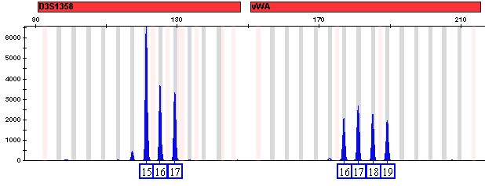
Forensic DNA Analysis
Forensic DNA Mixtures
  Indistinguishable genotypes in the mixture - CPI
  Unable to distinguish which two alleles belong to a donor
  Must consider all possible genotypes that could be present in the mixture
  The frequency of each possible genotype at the locus are summed and the combined frequency is multiplied at each locus
  Combined Probability of Inclusion (CPI) – proportion of a given population that would be expected to be included as a potential contributor to an observed DNA mixture
    No use of peak height data (contributor amounts)
    No assumption to the number of contributors
    Assuming all alleles are present from the contributors
15,15
16,16
17,17
15,16
15,17
16,17
POI = 16,17
POI = 17,18
16,16 16,18
17,17 16,19
18,18 17,18
19,19 17,19
16,17 18,19
+
X
+
Not using all available data
Are you sure?
Notes:
Does not make use of all of the data, and any genotype not present excludes the person, it may be ‘conservative’ but you are including many genotypes (people) who are not the donor

Slide 36
Forensic DNA Analysis
Forensic DNA Mixtures
  Indistinguishable genotypes in the mixture
  Unable to distinguish which two alleles belong to a donor
  Must consider all possible genotypes that could be present in the mixture
  The frequency of each possible genotype at the locus are summed
  The combined locus frequency is multiplied across loci
  Combined Probability of Inclusion – Probability of selecting an unrelated individual at random in the population that could be a potential contributor to the mixture
      No assumption to the number of contributors
      No use of peak height data (contributor amounts)
      Assuming all alleles are present from the contributors
“Two or more donors of human DNA, in which POI #2 is not excluded, was observed on the swabbing from knife. Assuming all possible genotype combinations of genetic loci examined, the approximate combined probability of inclusion (CPI) has been calculated. The CPI is the probability of selecting an unrelated individual at random in the population that may have been a contributor to the observed genetic mixture.
The CPI is 1 in 800.”
15,15
16,16
17,17
15,16
15,17
16,17
16,16 16,18
17,17 16,19
18,18 17,18
19,19 17,19
16,17 18,19
+
X
+
Notes:
If someone does not have one of these, they would be excluded. Not a good use of data for first two. All data present?

Slide 37
Forensic DNA Analysis
Forensic DNA Mixtures
  Indistinguishable genotypes in the mixture - CPI
  Assumed number of contributors (NOC = 2)
  Assumed equal contribution from each donor (1:1 ratio)
  The fewer potential genotypes provide additional discrimination
  The frequency of each possible genotype at the locus are summed and multiplied at each locus (we have restricted the possible genotypes)
      No use of peak height data (contributor amounts)
      No assumption to the number of contributors
      Assuming all alleles are present from the contributors
15,15
16,16
17,17
15,16
15,17
16,17
POI = 16,17
POI = 17,18
16,16 16,18
17,17 16,19
18,18 17,18
19,19 17,19
16,17 18,19
+
X
+
Using more of the data ✓
Are you sure?
Notes:
Does not make use of all of the data, and any genotype not present excludes the person

Slide 38
Forensic DNA Analysis
RMP and CPI (as described) assume that both alleles from the contributor are present at each locus
With low quantity and / or quality of DNA in forensic samples…that does not always happen
Notes:
Binary interpretation….. Moving to probabilistic interpretation

Slide 39
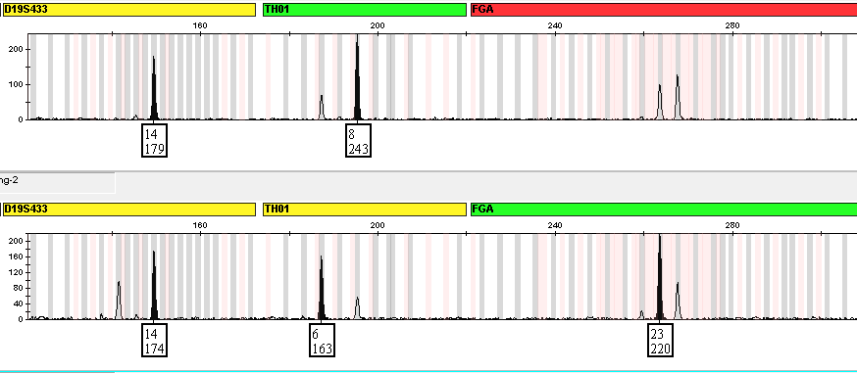
Forensic DNA Analysis
Stochastic amplification – random variation of peak heights within an STR profile
  This is the same low quantity single source profile in two separate PCR reactions
  Seen as variation of the two heterozygous peaks at a locus from the same contributor and can lead to allele drop-out or entire locus drop-out
  Results from a random sampling of alleles during the PCR process
  The lower the quantity / quality of input DNA, the higher the stochastic effects
12,14
6,8
23,24
Amplification #1
Amplification #2
Notes:
31 picogram (6-7 cells), do not meet a detection threshold, ground truth known

Slide 40
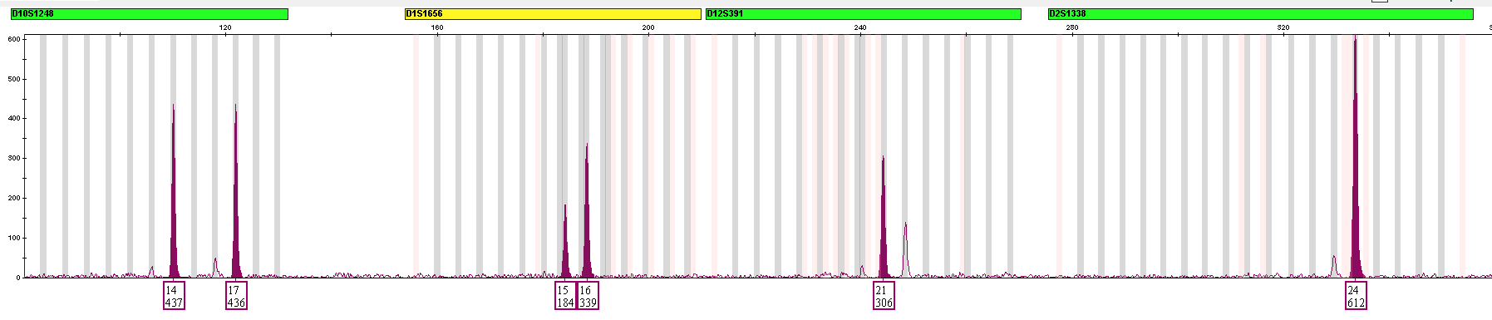
Forensic DNA Analysis
Thresholds
  Analytical Threshold – The value in RFUs (Y-axis) that distinguish a true allele from baseline noise with a high degree of confidence (detection threshold)
  Stochastic Threshold – The value in RFUs (Y-axis) where it is reasonable to assume that allele drop-out of a heterozygote sister allele has not occurred at the locus
  Application of the AT and ST is straight forward with single source samples, but the ST becomes less supportive with DNA mixtures
Stochastic Threshold
Analytical Threshold
14,17
15,16
21, ?
24,24
Notes:
31 picogram (6-7 cells), do not meet a detection threshold, binary approach

Slide 41
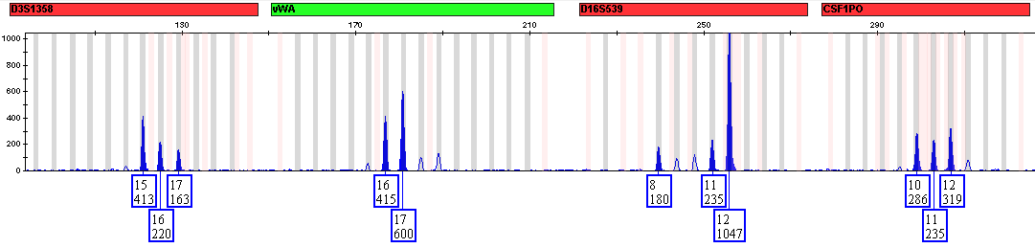
Forensic DNA Analysis
The complexity of DNA interpretation is increasing
  Multiple contributors to a sample
  Low quantity of DNA resulting in allele drop-out
  Degraded samples
  Allele sharing (stacking)
  Peak artifacts (stutter)
  A less binary and a more probabilistic approach of determining the genotypes that best explain this data is required……STAY TUNED!
Notes:
Even with thresholds, determining all possible combinations, kits and instrumentation is more sensitive is good – but still have limitations

Slide 42
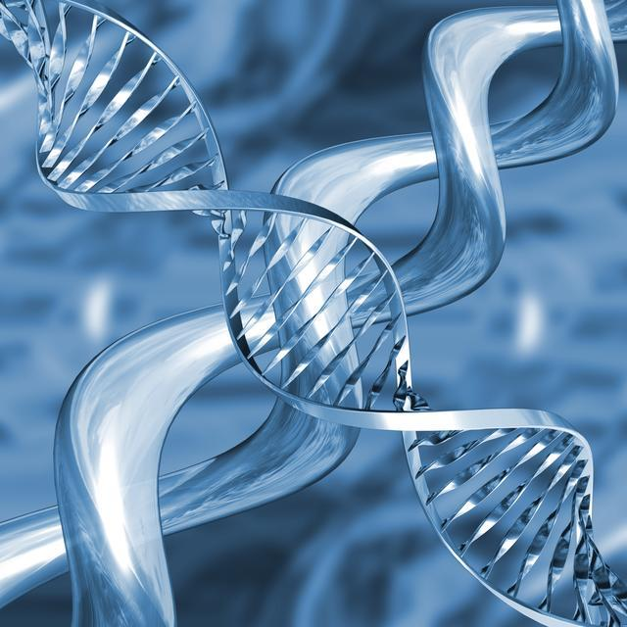
Thank you
Bexar County Criminal Investigation Laboratory
Garon Foster (210) 335-4150
gfoster@bexar.org

